Slide 1

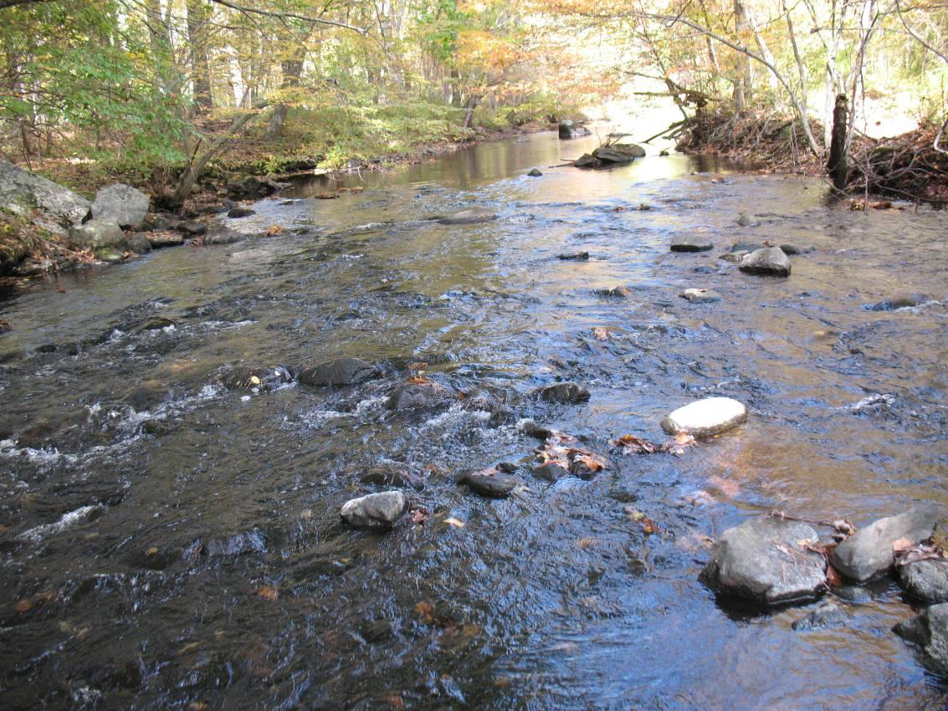
Streamflow Protection in the Little River :
A Case History of Securing Environmental Flows Below a Public Surface Water Supply
Murphy, Brian D^{.1}, Piotr Parasiewicz², and Wayne H. Bugden³. ¹Connecticut Department of Energy and Environmental Protection, Inland Fisheries Division, Marlborough, CT 06447, ²Rushing Rivers Institute, Amherst, MA 01002 and ³CME Associates, Inc. Woodstock, CT 06281; brian.murphy@ct.gov

Slide 2
Summary of Surface Water Diversion
The Town of Putnam diverts surface water from the Little River for the municipal water system. The diversion has occurred since the construction of the dam and water treatment facilities in the late 1800’s.
Sole source of water supply until the 1970’s when groundwater wells developed along the nearby Quinebaug River.
The diversion occurs on a run of river (real time basis) e.g. the diversion is a percentage of the flow in the river with the remainder flowing downstream.
Max.day withdrawal – 1.8 mgd (2.8 cfs).
Mean day Max Month – 1.5 mgd (2.3 cfs).
Notes:
.

Slide 3
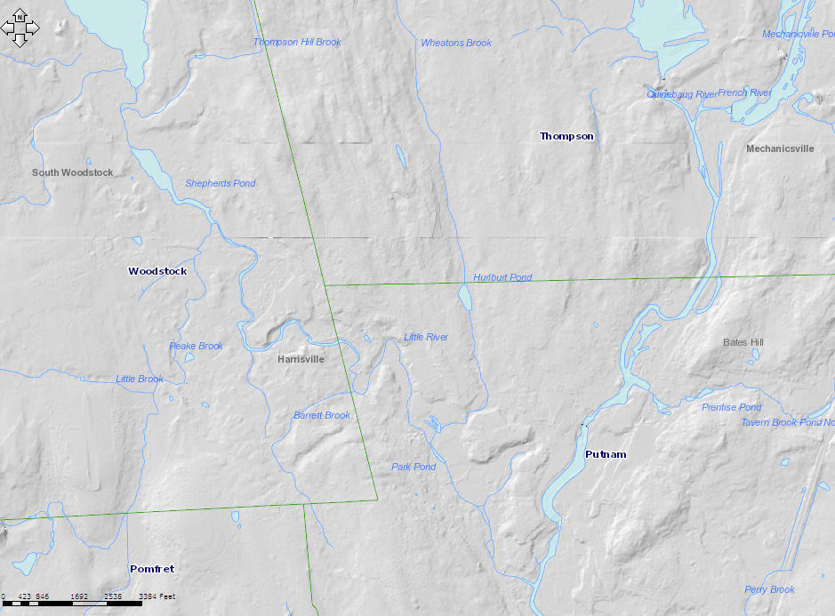
3rd order stream, Tributary of Quinebaug River
  (43% forest/13% developed)
The watershed size at point of diversion - 35.4 mi²
Approximately 2.4 miles of river are impacted
Little River Diversion
Putnam wellfield
Notes:
Little river in northeast CT, not a lot of development for CT standards
As a matter of reference is the town’s other water supply groundwater wells.

Slide 4
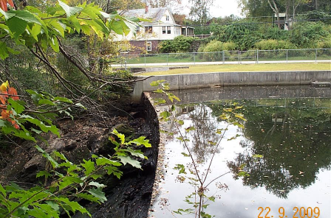
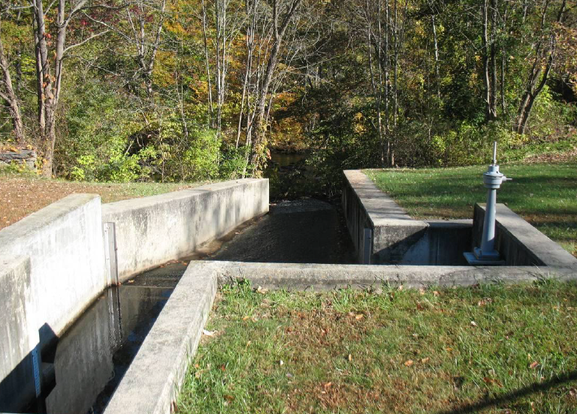
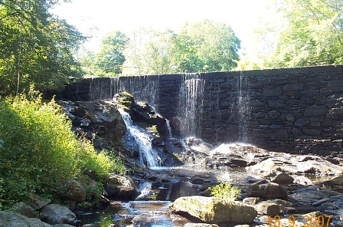
Withdrawal at Dam via Bypass Headworks to Water Treatment Facility
20 ft. in height
Notes:
Small inline impoundment, Dam approx. 100 ft. across by 20 ft. in height. Somewhat typical small new england dam.

Slide 5
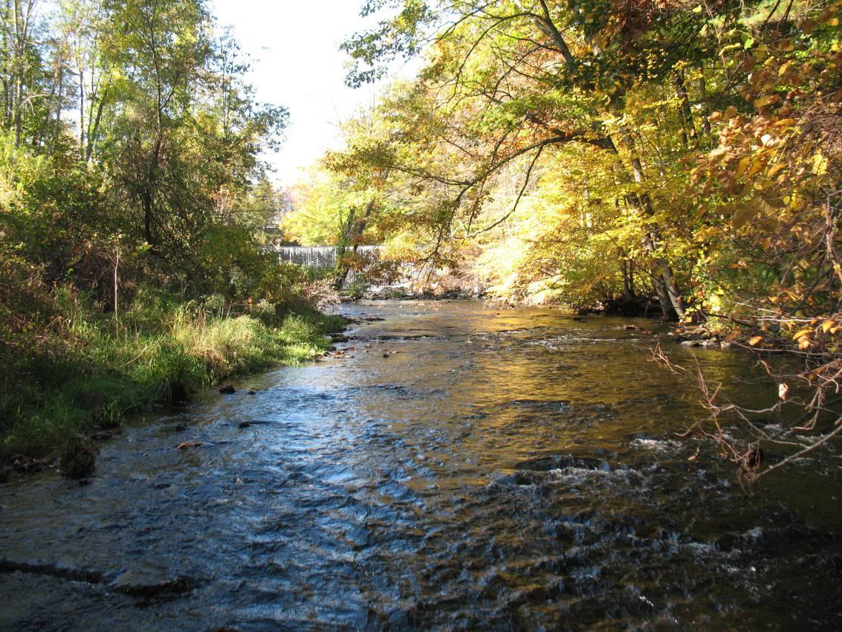
Moderate-higher streamflows decreased impacts to habitats below diversion
Notes:
During moderate to higher streamflow events, decreased impacts instream habitats since diversion is a smaller percentage of overall streamflow HOWEVER!!!

Slide 6
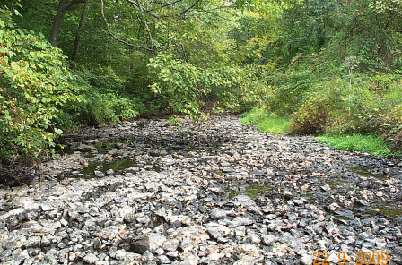
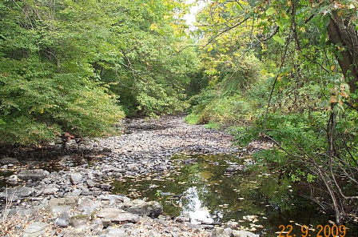
Low Flow Periods: Periodic Events Cause Significant Reduction of Instream Habitats
Dewatered and disconnected habitats in upper reaches
Limited pool /refuge habitat :
first downstream most holding pool is 0.3 miles from point of diversion.
Notes:
Physical effects observed most in upper reaches
Limited pool or refuge habitat, first downstream most significant holding pool is 0.3 miles from point of diversion,
Never observed stranding or fishkills but not always there when events occurred.

Slide 7
Little River Diversion: Synopsis Historic Timeline of Regulatory Actions
CT Water Diversion Act
Ground/surface water
>50,000 gpd need to register or permit.
Town fails to register!
DEP advises town violation to be resolved through consent order
Town files diversion application :
CTABF downstream protection
Town fails to submit permit application
1982
1984
1990
2000
2002
2005
2007
Town requests permit need. DEP Permit app required by 1990
Notice of Violation issued for unpermitted diversion
Consent order (fined)
allow 1.5 mgd -3 yrs
Submit permit app
Notes:
One might easily call it Regulatory (Inaction)!!!
All Existing diversion were grandfathered just had to register
1990-2000 Dead period Took 10 years to issue notice of violation in 2000!!! NOV has little regulatory teeth, sort of a warning. Town had good environmental lawyer

Slide 8
Connecticut Aquatic Base Flow (CTABF) Standard Setting Method (IFD policy)
CTABF based solely on streamflow data collected in “10 unregulated” basins in CT
that had at least 30 years of gage records.
Standard is median of daily flows for each month (cubic feet /mi² of drainage), as
developed by Apse (2000).
Little River drainage : 35.4 mi²
MONTH | CFSM | CFS
January | 1.53 | 54.15
February | 1.77 | 62.64
March | 2.60 | 92.02
April | 2.54 | 89.90
May | 1.63 | 57.69
June | 0.77 | 27.25
July | 0.33 | 11.68
August | 0.23 | 8.14
September | 0.22 | 7.79
October | 0.45 | 15.93
November | 1.14 | 40.35
December | 1.52 | 53.80
Literature Cited
Apse, C.D. 2000. Instream flow protection in New England: Status, critique, and new approaches to standard-setting. Masters Thesis., Yale School of Forestry and Environmental Studies. 112 pgs.
Notes:
CTABF was our policy at the time, CTABF still used as a starting point of discussion for instream flow protection especially at hydro facilities.

Slide 9
Little River Diversion: Synopsis Historic Timeline of Regulatory Actions
Town withdraws application.
Est. shutdown 50% time.
Instream Flow Assessment using MesoHABSIM Approach
DEP issues water diversion permit with downstream flow protection
2008
2009
2010
2011
2013
2014
New Consent order issued
Town submits water diversion permit application
Groudwater diversion permit application
Notes:
Following year application withdrawn
2009 new consent order issued which was a game changer!

Slide 10
DEP 2009 Consent Order Highlights
Unpermitted diversion allowed for 3 years not to exceed 1.5 mgd
Provide downstream flow protection (July – October) Use CTABF standards.
Instream Flow Study had to be performed and submit new water diversion
permit application!
Secure diversion permit for expansion of groundwater wellfield
(increase 0.65 mgd to 1.18 mgd.) Reduce reliance on Little River: July-October
Interconnect with CT Water Company
    (not preferred since have to pay for water!)
Notes:
!

Slide 11
Little River Diversion: Synopsis Historic Timeline of Regulatory Actions
Town withdraws application.
Est. shutdown 50% time.
Instream Flow Assessment using MesoHABSIM Approach
DEP issues water diversion permit with downstream flow protection standards
2008
2009
2010
2011
2013
2014
New DEP Consent order
Town submits water diversion permit application
Permit issued for expansion
of wellfield
Notes:
A lot of action in short period of time, after the 2009 consent order. Town finally recognized that would have to permanently allot water for downstream protection.
2009 consent order finally influenced town to be proactive in not only getting permit but protecting downstream resources but it took 32 years to get there!!!!!

Slide 12
Instream Flow Assessment using MesoHABSIM and Target Fish Community Approach
(Parasiewicz, P. 2008)
Town’s water management consultant CME Associates contracted Piotr Parasiewicz of Rushing Rivers Institute to conduct study.
Our agency had prior review experience with other ISF studies using MesoHABSIM approach
Ex.) UCONN groundwater supply next to Fenton River. Study results used to “throttle” down withdrawals during low flow periods with eventual curtailment of withdrawals.
Parasiewicz, P. 2008. Application of MesoHABSIM and Target Fish Community
Approaches to Restoration of the Quinebaug River, Connecticut and Massachusetts.
River Research and Applications .
Notes:
UCONN poster child for water supply drying up a river
Rest of the presentation I’m going to quickly describe components of study, results and water supply management.
Talk to me later or I have copy of study if you want more details.

Slide 13
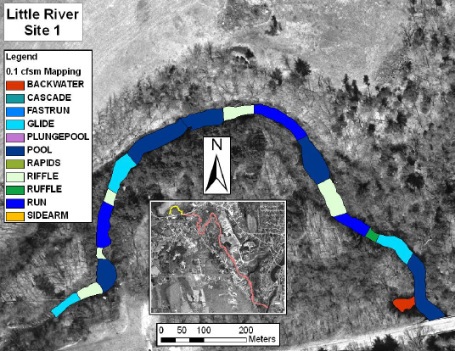
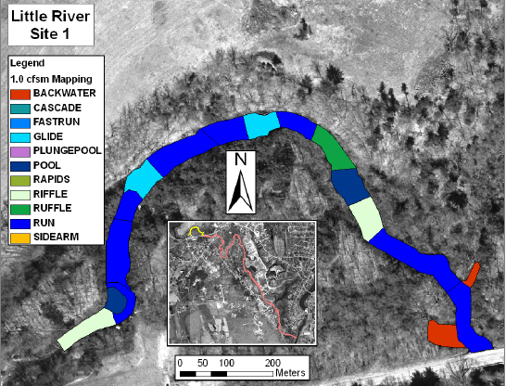
HABITAT MAPPING COMPONENT
0.1 cfsm
1.0 cfsm
Mesohabitat mapping of study reach 2.4 miles under multiple flow conditions (5 target flows - 0.1 to 2.0 cfsm).
Results show variation in spatial distribution of mesohabitats.
(e.g. backwater habitats increase as flow increases)
Notes:
Field intensive, full day for each target flow

Slide 14

Target Fish Community Approach
(Utilize methods as described by Bain and Mexler 2000)
Purpose is to define the expected (target) structure of the native fish community
as a baseline for comparison to the existing fish community.
TFC was developed using 5 reference streams in CT and MA that reflect relative
healthy ecosystems “least altered” by human disturbances
(Selection reference streams: Stepwise iterative process, stream order, drainage area, EcoRegion).
The TFC is developed (basically a ranking system using percent model affinity
procedure) and compared to the Existing Fish Community (XFC).
(6 IFD electrofish sample sites on Little River)
The suitability of mesohabitats was assessed for the TFC .

Slide 15
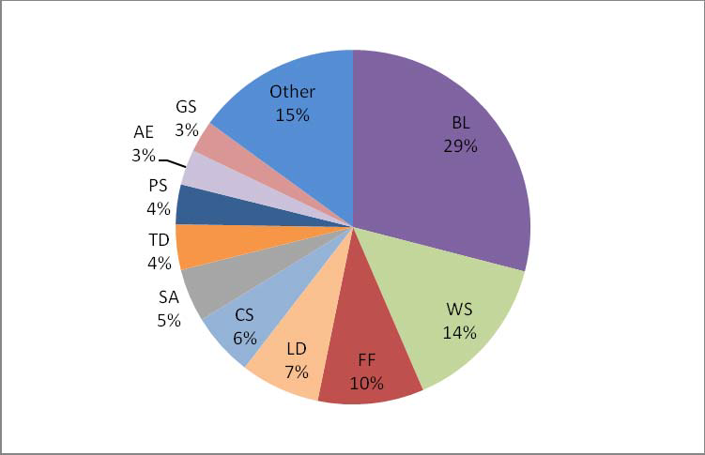
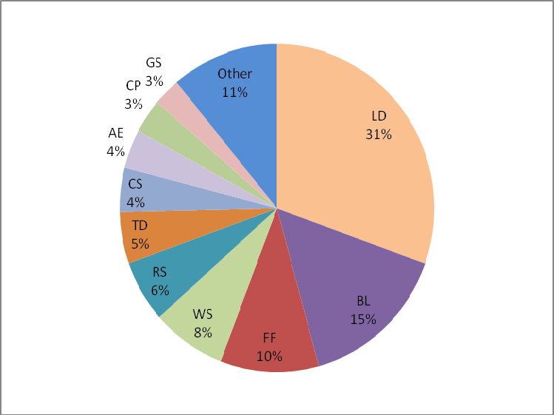
Target Fish Community
Blacknose dace (29%)
White sucker (15%)
Fallfish (10%)
Longnose dace (7%)
Common shiner (5%)
Tessellated darter (4%)
Percent Model Affinity Index - 73%
(extent of the match)
Little River Fish density below state average 0.44 fish/m² to 0.18 fish/m²
Low density adult, pool dwelling (WS,FF) and high abundance of small BL, LD
Target
GRAF
Existing
Notes:
Collective called generic resident adult fish (GRAF)
High abundance of juvenile fish , lack of adult larger adult ws and ff suggesting some type of bottleneck

Slide 16
CT Streamflow Standards Established 6 Different Bioperiods
Bioperiod is timeframe when biological process depend on seasonal variability of streamflow
EX)Rearing and Growth Bioperiod: Lowest flows occur frequently (July -October) Aquatic life depends upon sufficient streamflow to grow and survive.
Little River Study Bioperiods and Indicators
BIOPERIOD | Model Indicator
Overwintering (Dec. –Feb) | Flow
Habitat Forming (March-April) | Flow
Clupeid Spawning (May) | Blueback Herring
Resident Spawning (June) | Generic Resident Adult Fish (GRAF)
Rearing & Growth (July-October) | Generic Resident Adult Fish (GRAF)
Salmonid Spawning (November) | Atlantic Salmon
Notes:
GRAF serve as indicators for resident spawning and Rearing and growth or (summer habitat needs) time periods when flows most affected by the diversion

Slide 17
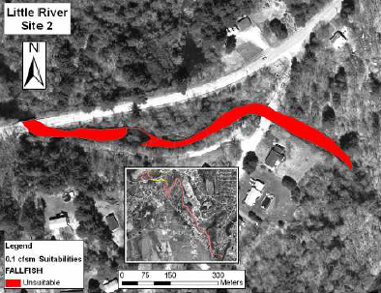
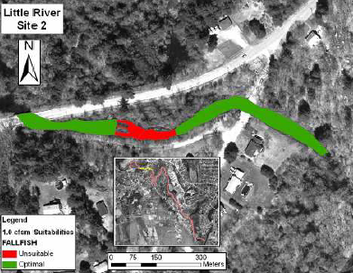
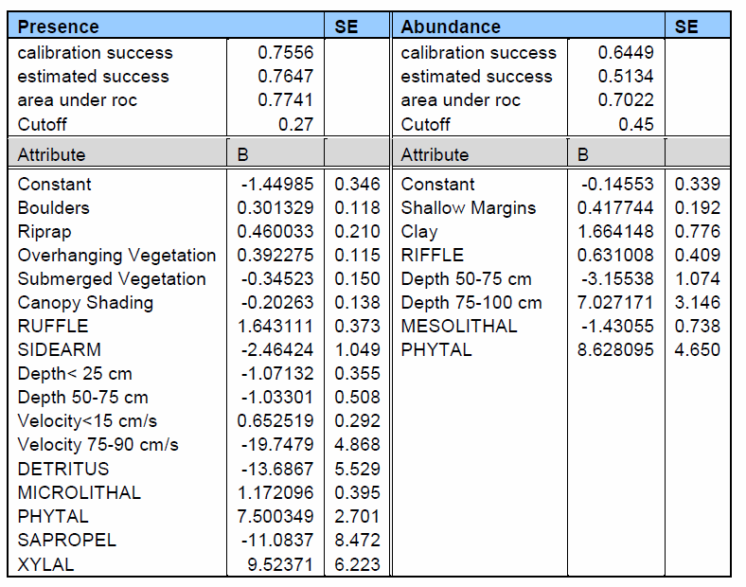
HABITAT SUITABILITY
0.1 cfsm
1.0 cfsm
Fish habitat selection models developed using
SimStream software.
Habitat suitability criteria based upon empirical data.
Multivariate statistical analysis used to identify criteria as:
non-suitable (red)
suitable (yellow)
optimal (green)
Notes:
Suitability of mesohabitats determined for fish species at various flow regimes

Slide 18
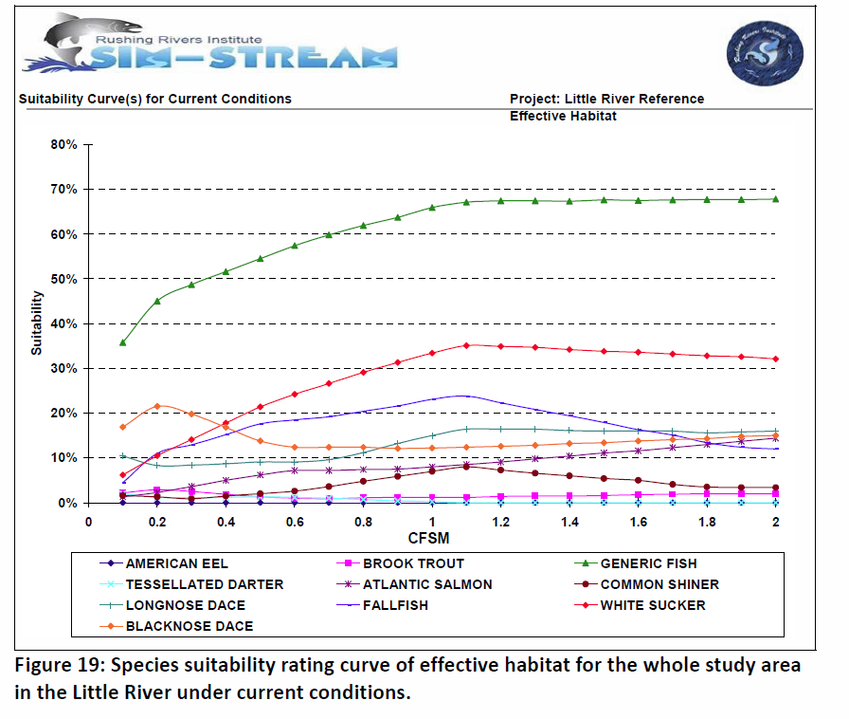
Habitat Rating Curves
Generic Resident Adult Fish
Total habitat for each species (suitable and optimal) habitat was quantified for each flow as proportion of river channel.
Notes:
so for generic fish community quite of bit of habitat at 0.1 cfsm, which would be 3.5 cfs

Slide 19
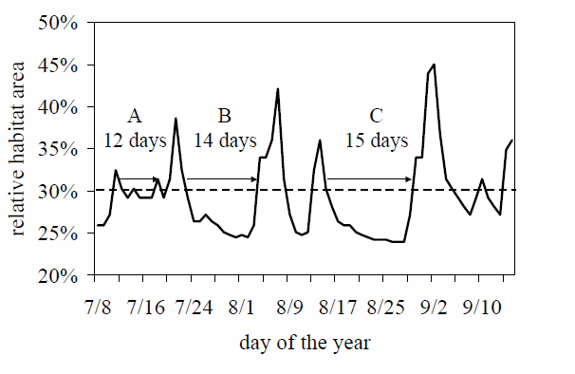
Develop Uniform Under Continuous Threshold (UCUT) habitat curves
Translate hydrologic time series developed from surrogate gage (70 yrs) into habitat time series
Extract bioperiod data from:
“habitat events – number days under predefined threshold”
Schematic of UCUT curve computation for hypothetical habitat time series
Notes:
There are multiple steps in developing UCUT curves which would take awhile to explain, but basically ……translate flow time series into habitat time series and extract data from” habitat events in number of days”

Slide 20
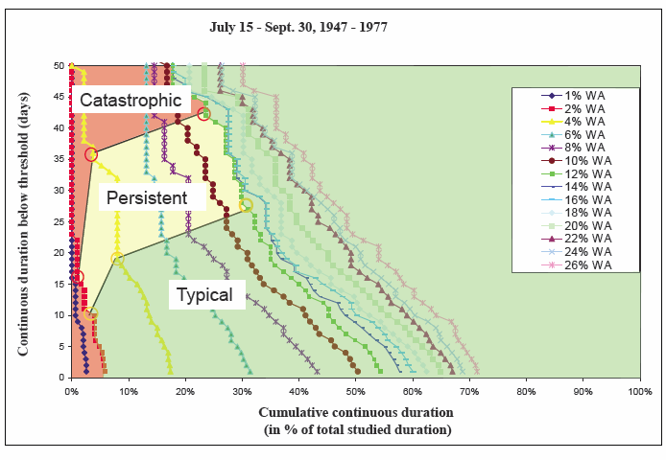
Example: UCUT Curve : Frequency and duration zones
Purpose to investigate flow patterns & conditions stressful to aquatic fauna
Catastrophic events:10 yr.
Persistent (Rare 2-3 yr)
Common events

Slide 21
Bioperiod Flow and Duration Threshold Matrix
BIOPERIOD | TRIGGER Critical Habitat Level |  | SUBSISTENCE Rare Habitat Level
 | Flow (cfs) | Allowable Duration (Days) | Flow (cfs) | Allowable Duration (Days)
Overwintering (Dec. –Feb) | 17.7 | 11 | 14.2 | 10
Habitat Forming (March-April) | 38.9 | 8 | 31.9 | 7
Clupeid Spawning (May) | 18.4 | 4 | 15.9 | 3
Resident Spawning (June) | 7.8 | 5 | 6.0 | 4
Rearing & Growth (July-October) | 2.5 | 16 | 2.1 | 13
Salmonid Spawning (November) | 10.3 | 10 | 8.5 | 5
Trigger flow value corresponds to critical habitat level and intended to trigger management actions.
Withdrawals do not continue if Little river flows decrease to levels less than the trigger or subsistence level.

Slide 22
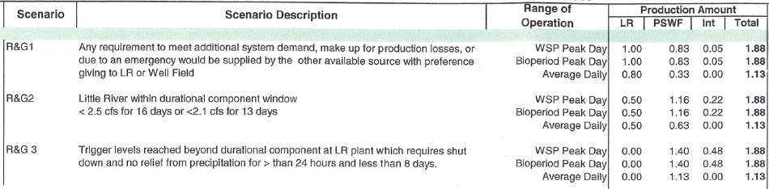
Develop System Wide Comprehensive Management Plan
Based upon Bioperiod Triggers
Example) Rearing and Growth Bioperiod
Reduce reliance on Little River diversion by throttle back peak withdrawals from
1.8, 1.0 mgd, 0.5, then zero.
Subsequently increase reliance on groundwater wells and interconnection to CT Water Company

Slide 23

Future Efforts
1. IFD will monitor fish community in Little River. Provides opportunity to assess biotic response to downstream flow protection program.
2. Per permit conditions, town provides annual report describing detailed operation of Little River diversion and entire system.

